Slide 1
Far Western University
School Of Engineering
Digital Clock Presentation
This Presentation is based on Simulation Of Digital Clock

Slide 2
Digital Clock
Digital Clock Simulation Using Proteus

Slide 3
Our Team
Pradip Bhatt
Santoshi Ayer
Suna Chaudhary
Yashoda Badu

Slide 4
Introduction
01
Digital clock with BCD counters is a digital clock with display for hours, minutes and seconds.
This clock is based on Decade Counter.
About Used Components
02
Components like 7 sec Decade Counter 555 timer triple input AND gate Voltage Source Resistor Capacitor 7 Sec Display.
Firstly we design Timer Circuit then for Seconds ,Minutes And Hours.
Circuit Design Analysis
03
We design timer circuit for producing Clock Pulse Firstly.
Produced Clock Pulse is Passed to input of Decade Counter and process begins.
Our
Topics
Conclusion
04
After design complete circuit we proceed for simulation.
If simulation succeeds then we’ll make that clock practically.

Slide 5
Presentation Timeline
Objectives
1)Understanding the basic principles of timekeeping and clock design.
2)Learning how to use a 555 timer as an oscillator and clock generator.
3)Gaining experience with digital circuits and circuit design..
Conclusion
Introduction
The design of the digital clock is versatile and adaptable for different applications.
It can be easily modified and updated when improvements are required.
The use of standard components and a simple design make it cost-effective and easy to maintain.
Digital Stop watch Circuit can be Worked as a clock in this counter will advance after every one second.
When you provide the power supply it starts it’s counting from zero and it can be used in playing games, studying etc.
3-6min
10-20min
0-3min
6-10min
20min
Components used
Working
555 timer
Decade counter
BCD to seven segment decoder
7 segment display
Frequency Generator
Proteus simulator
Basic logic gates
Digital clock works by using the 555 timer to generate a clock signal, which is used to drive the counters. The counters count the clock cycles and output the current time in binary format. This binary output is then decoded and sent to the 7-segment displays, which display the current time in a digital format..

Slide 6
Components
555 Timer
3 input Positive AND gate
The 555 timer can also be used to generate a time base for the clock, for example, by using it in monostable mode to generate a one-shot pulse of precise duration. This pulse can then be used to trigger a counter circuit, which counts the number of pulses and displays the count on a 7-segment LED display.
3-input positive AND gate can be used in digital clock formation as a means to control the timing of the clock. It receives inputs from the clock source, counter circuit, and divider circuit, and only allows the counter circuit to increment its count when the input from the clock source and divider circuit is high. This ensures that the clock's timing is accurate and stable.
7segment cathode display
The seven-segment cathode display is connected to a digital counter circuit, which counts the number of pulses generated by the clock and displays the count on the display. The counter circuit uses the pulses from the clock to increment the count and then uses the count to determine which segments of the display should be lit to display the current time..
Resistors
Resistors play an important role in the formation of a digital clock circuit by limiting current, dividing voltage, and setting timing. They are used to protect the circuit, adjust voltage levels, and control the timing of the clock, ensuring that it is accurate and stable.
7 segment Display Decade Counter
Capacitor
The counter is driven by the pulses generated by the clock and increments the count with each pulse. The decoder then converts the binary count into the corresponding decimal digits, which are used to activate the appropriate segments of the seven-segment LED display to display the current time.
Capacitors play an important role in digital clock formation using a timer 555 by controlling the timing, stabilizing the operation, decoupling the power supply and controlling the discharge time of the voltage. They are used to adjust the timing of the clock, ensure that the circuit operates smoothly, and prevent noise and ripple on the power supply.

Slide 7
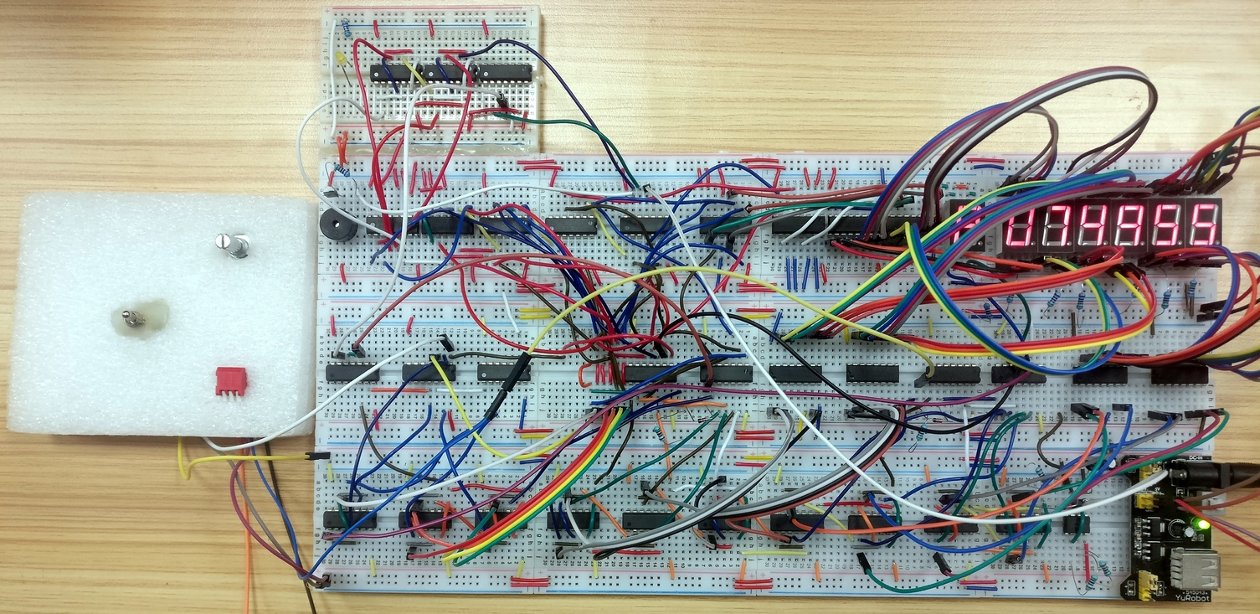
We Set up Clock By following Steps
A practical overview of a digital clock simulation using a 555 timer, decade counter, and 7-segment display would involve the following steps:
Designing the circuit: The first step is to design the circuit using the 555 timer, decade counter, and 7-segment display. This includes selecting the appropriate components, such as resistors and capacitors, and connecting them in the correct configuration to create the clock circuit
. Powering the circuit: The next step is to provide power to the circuit. This can be done by connecting a DC power supply to the circuit. The voltage and current required will depend on the specific components used in the circuit.
Setting the timing: Once the circuit is powered, the timing of the clock can be adjusted by adjusting the values of the resistors and capacitors in the timing network. This will determine the frequency of the clock pulses generated by the 555 timer.
Displaying the time: The 7-segment display is used to display the time. The decade counter is used to count the clock pulses and provide the appropriate input to the display to show the current time.
Practical
Overview
Digital Clock ,

Slide 8
Time Analysis
85%
30%
A 1
B 2
C 3
Hour Counting
Firstly we design circuit for 555 timer.
50%
Minutes Displaying

Slide 9
Circuit Design Analysis
555 timer
The 555 timer is used as the heart of the circuit, it generates regular pulses or oscillations. These pulses are then used to drive the clock mechanism. The timing of these pulses is determined by the values of the resistors and capacitors in the timing network..
01
Decade counter
Resistors and Capacitors:
The decade counter is used to count the clock pulses generated by the 555 timer. It takes the input from the timer and provides a set of output pins, each representing a different digit in the clock display..
02
04
Resistors and capacitors are used in the circuit to control the timing and operation of the clock.
7-segment display
03
The 7-segment display is used to display the time. It takes the input from the decade counter and lights up the appropriate segments to show the current time..

Slide 10
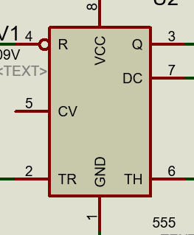
Control voltage input(Vcc)
555 Timer Circuit
A 555 timer IC (Integrated Circuit) is a small, low-cost device that is widely used in various electronic circuits. It consists of the following main components:
This allows the user to adjust the timing of the circuit by connecting an external voltage source to the control voltage pin..
Discharge Transistor
This is used to discharge the external capacitor connected to the timer.
Output
The output pin provides the square wave output generated by the flip-flop.
Ground and VCC pin
The IC needs a power supply to operate which is given by the Ground and Vcc pin.

Slide 11
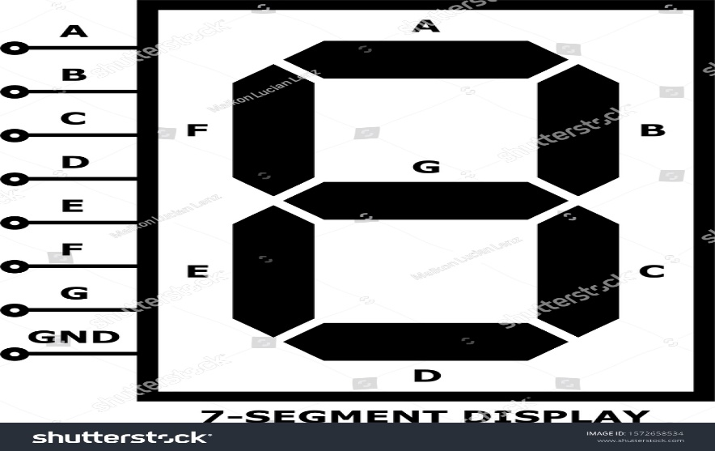
7segment Cathode Display
7 Segments
These are the seven individual segments that make up the display. Each segment is a light-emitting diode (LED) or a liquid crystal display (LCD) and can be illuminated to form a number.
Cathodes
Each segment has a corresponding cathode pin. When a current is applied to a cathode pin, the corresponding segment lights up.
Anode Pin
There is an anode pin which is common for all the segments.
Power Supply
A DC power supply is used to provide power to the display and to illuminate the segments.

Slide 12
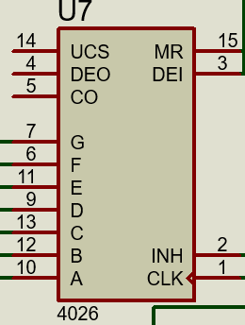
7segment Decade Counter
A binary Counter
This is the main counting component of the circuit. It can count from 0 to 9 in binary and produces a set of outputs that correspond to the current count.
BCD Decoder
This component converts the binary count into a decimal (base 10) representation.
7 Segment Display Driver
This component takes the decimal output from the BCD decoder and drives the 7-segment display to show the current count.
Clock Source
A clock signal is needed to drive the binary counter and increment the count.

Slide 13
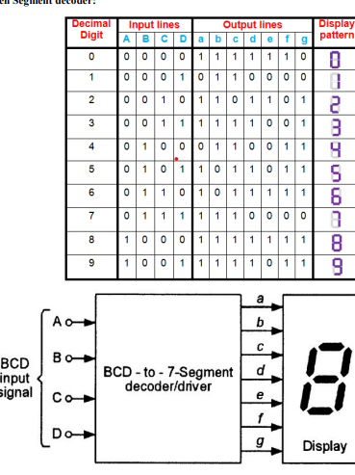
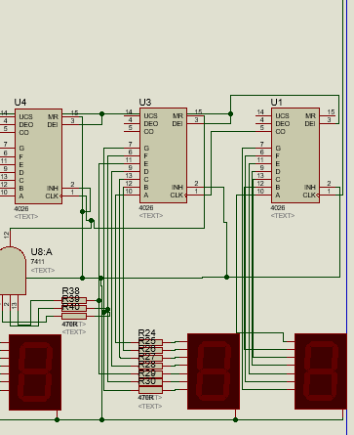
Circuit Design Of Second Decoder And 7 segment Display
Truth Table of 7 segment Decoder
Circuit Design Presentation
ALLPPT Layout Clean Text Slide for your Presentation

Slide 14
Seconds
Seconds can be counted as
In the digital clock simulation using a 555 timer, decade counter, and 7-segment display, the seconds are counted by the decade counter.
The 555 timer is configured as an oscillator and generates a constant clock signal. This clock signal is then fed into the decade counter, which counts the number of clock pulses. The decade counter is a binary counter that counts from 0 to 9 and produces a decimal output. The decimal output is then used to drive the 7-segment display, which shows the current count.
In this clock simulation, each count of the decade counter represents one second. As the decade counter counts from 0 to 9, it completes one cycle every 10 seconds. This cycle is repeated continuously and keeps counting the seconds. The decade counter counts the seconds and the 7-segment display shows it, thus giving the time in terms of hours, minutes and seconds. Additionally, the clock can be designed to have additional decade counters to count minutes and hours, so that it can display full time.

Slide 15
Minutes
Minutes can be counted as
In the digital clock simulation using a 555 timer, decade counter, and 7-segment display, minutes can be counted by cascading another decade counter with the one counting seconds.
When the seconds' decade counter reaches its maximum count, which is 9 in this case, it sends a carry signal to the minutes' decade counter. The minutes' decade counter receives this carry signal and increments its count by 1. This process continues until the minutes' decade counter reaches its maximum count, which can be 59 or another value depending on the design of the clock.
In order to display the minutes, another 7-segment display is used along with the BCD decoder that drives the seconds' display. This display is connected to the minutes' decade counter output, which shows the current minutes count.

Slide 16
Hour Counts as
Hours
In the digital clock simulation using a 555 timer, decade counter, and 7-segment display, hours can be counted by cascading another decade counter with the one counting minutes.
When the minutes' decade counter reaches its maximum count, which is 59 in this case, it sends a carry signal to the hours' decade counter. The hours' decade counter receives this carry signal and increments its count by 1. This process continues until the hours' decade counter reaches its maximum count, which can be 23 or another value depending on the design of the clock.
In order to display the hours, another 7-segment display is used along with the BCD decoder that drives the minutes' display. This display is connected to the hours' decade counter output, which shows the current hours count.

Slide 17
In conclusion, 7-segment display, and various other components is a common and practical application of these devices.
The 555 timer is used as an oscillator to provide a constant clock signal to the decade counter.
The decade counter is then used to count the clock pulses and produce a decimal output, which is then converted by a BCD decoder and used to drive the 7-segment display.
The display shows the current count, representing the time. Additionally, various other components like resistors, capacitors, AND gates, and power supply are used in the circuit to ensure proper functioning of the clock.
The circuit design is relatively simple and can be easily understood and modified to fit different requirements. Furthermore, the use of the 7-segment display allows for a clear and easy-to-read display, making it ideal for a variety of applications.
The digital clock simulation using the above-mentioned components can be a good class project, which provides hands-on experience in understanding the working of digital circuits and timing applications.
A
WESOME
PRESENTATION
For more details see our report.

Slide 18
THANK YOU
To Our Teacher ER. Kamal Lekhak and all of the friends

